Slide 1

Tourist Guidance System
Group members with student Id
21104005 Swapnil Joshi
21104008 –Karan Jain 3) 21104041-Yash Jain

Slide 2
Contents
Introduction
Objectives
Scope
Features / Functionality
Project Outcomes
Technology Stack
Block Diagram/ Flow

Slide 3
1. Introduction
Problem Identified :
There is always a language barrier between people of two different communities for communication.
People who don’t know nearby places to explore especially for foreigners.
Worried about where to go within their budget.
Solution Proposed :
Now users don’t have to ask any random people in their locality.
User will get the best possible location outcomes according to his/her budget entered.

Slide 4
2. Objectives
To save user’s time constraint an prevent him from getting false information from local people
To execute user’s travelling problems

Slide 5
3. Scope
Can be applied in tourism sector
Can be used by government to promote various tourism sites which people are not aware about.
Can be useful to locals as well as foreigners
It can be used by the people who are introvert and shy in nature.

Slide 6
4. Feature /Functionality
to provide statistics of user details
providing description of places for optimization of their choices
there is provision of booking hotels/restaurant/lounges/ homestays to stopover.

Slide 7
5. Outcome of Project
User can search for various tourist places available in Mumbai/Thane region according to his/her budget.
User can also book various hotel using this application which would make users journey very convinient and less hectic.
User can also visit public activities and enjoy local festivals

Slide 8
6. Technology Stack
1.-frontend–html,css,js
2.-backend–java,spring framework 3.-database–mysql

Slide 9
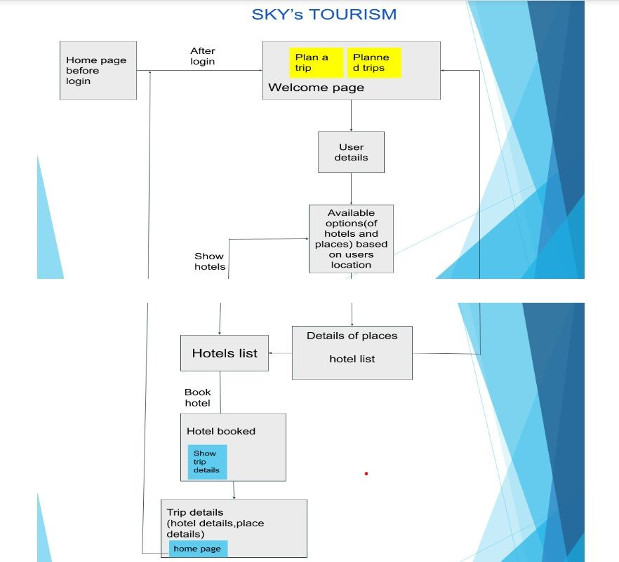

Slide 10
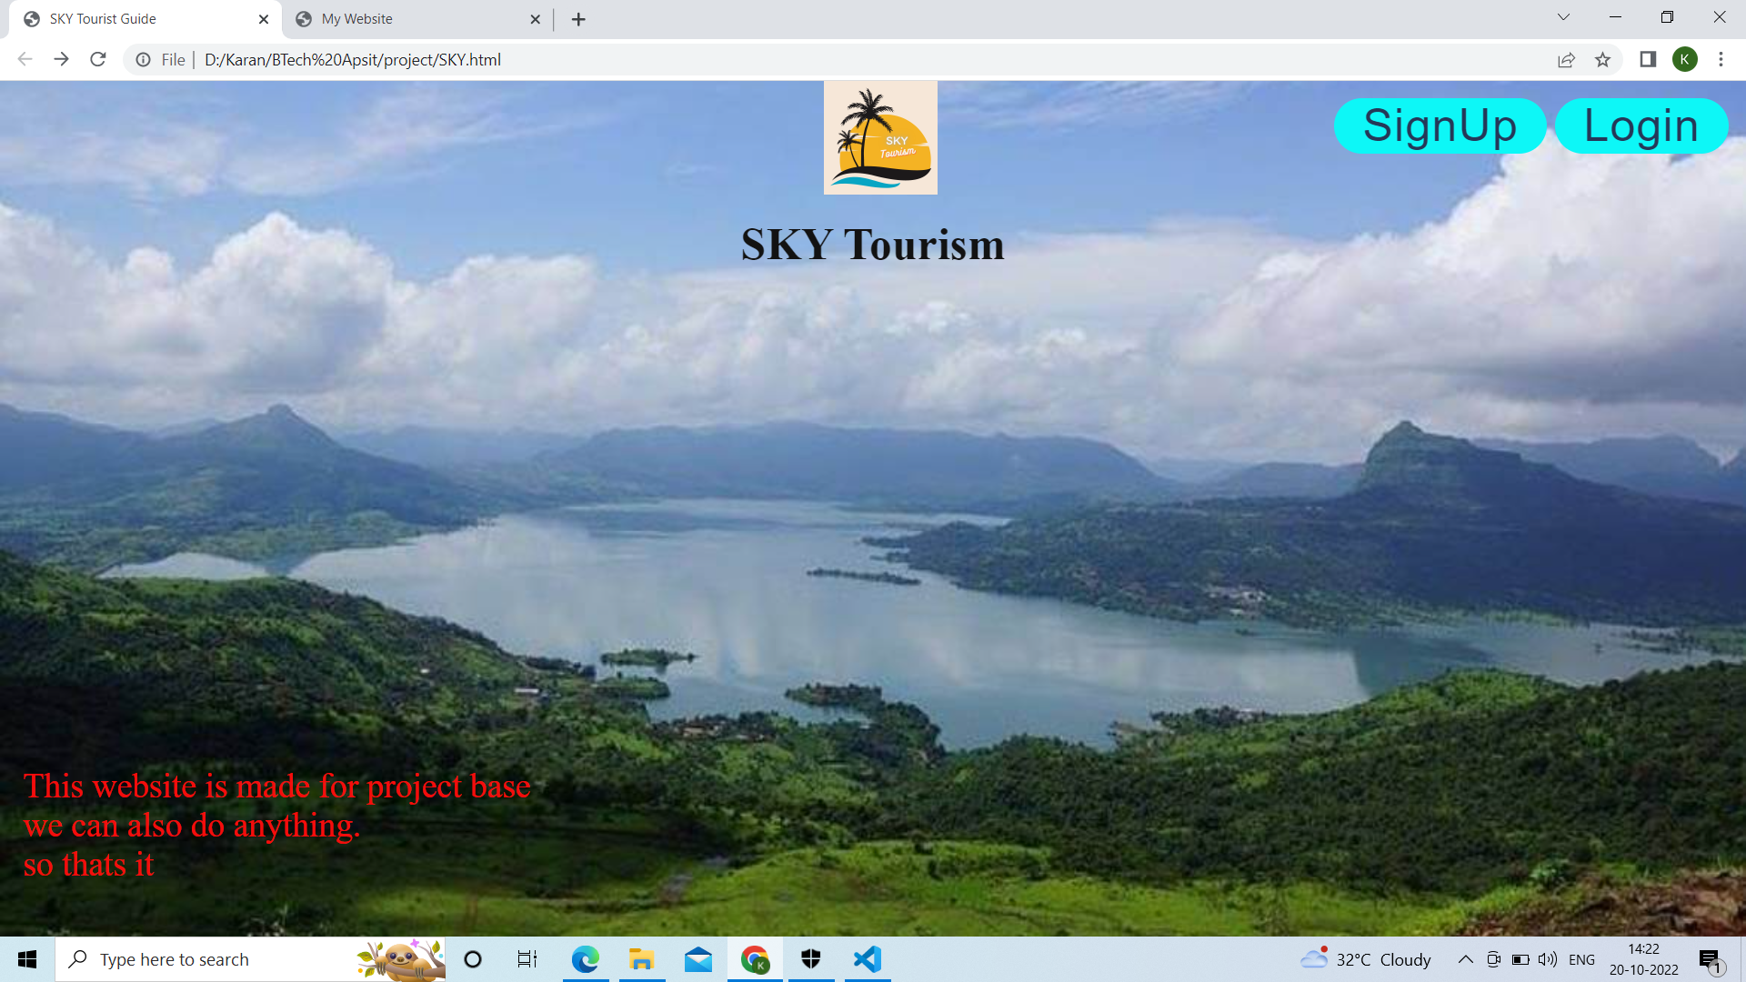

Slide 12
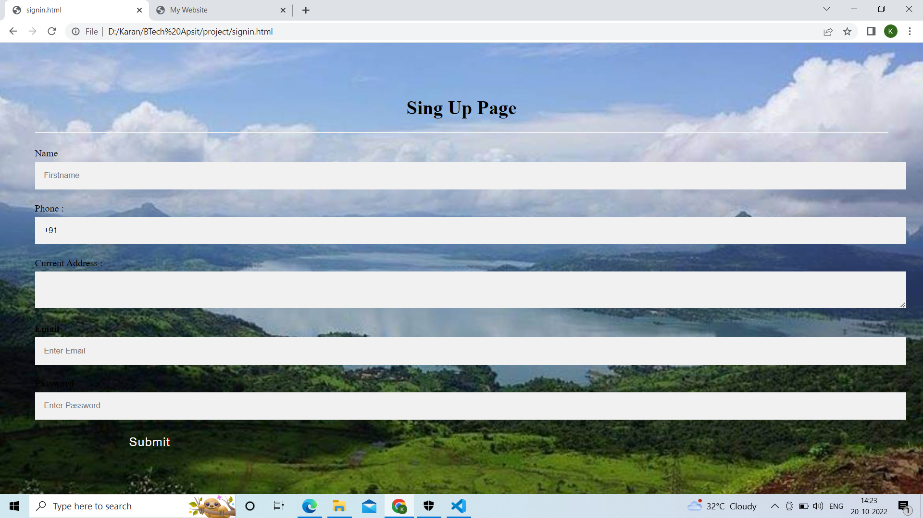

Slide 13
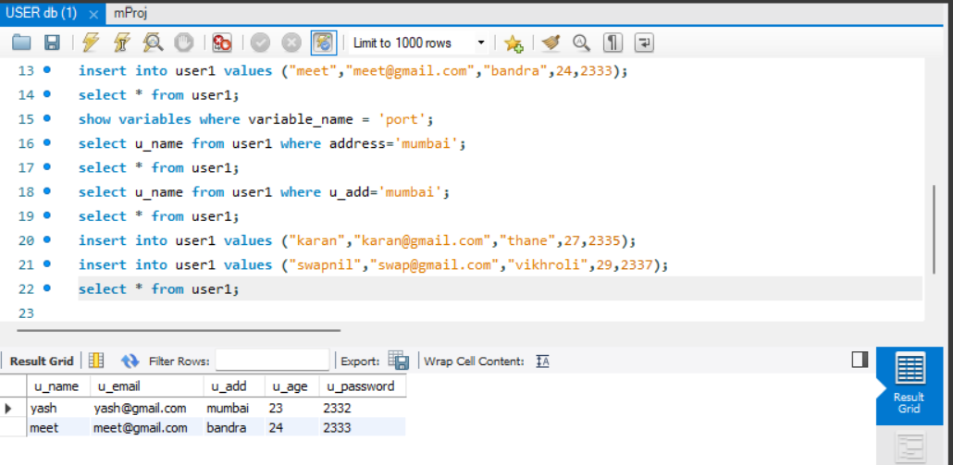

Slide 14
Thank You...!!

